Slide 1
ATIEL | EELQMS | SAIL
.
Argus Base Oils Conference Asia, Middle East & Africa
Why the European Engine Lubricants Quality Management System (EELQMS) is important for the Middle East and Asia lubricant Industry
9-11 October 2024 | Dubai, United Arab Emirates

Slide 2
Mike Boyer, Director | SAIL
Importance of Quality standards and the ACEA European Oil Sequences
The European Engine Lubricants Quality Management System (EELQMS)
Role of SAIL - Monitoring quality in the market
www.atiel.eu

Slide 3

Who are SAIL?
Subsidiary of ATIEL - The Technical Association of the European Lubricants Industry
Contracted by ATIEL to provide administrative, financial and management services in support of ATIEL’s global product compliance and Letter of Conformance activities on a non-profit making basis.
Manages the registration system of Letter of Conformance signatories
Responsible for managing ATIEL’s product compliance monitoring programme.
Licences the EELQMS quality trademark in association with ATC and ACEA.
www.atiel.eu

Slide 4
Importance of Quality standards and the ACEA European Oil Sequences
www.atiel.eu

Slide 5


Importance of quality standards
OEMs need to know that appropriate quality engine lubricants will be available in all their markets.
Trade/workshops need assurance that inadequate lubricant performance will not lead to warranty claims.
Consumers need confidence in quality of the products being used in their vehicles.
www.atiel.eu

Slide 6
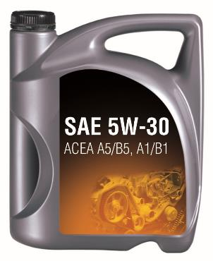
Quality and performance claims
Although, typically, an engine lubricant will carry a number of industry and OEM claims, today we will focus on ACEA
An ACEA claim represents the minimum level of performance required to provide basic protection. It is often quoted in vehicle handbooks as an alternative if an OEM approved lubricant is not available
How do you know that your products meet the ACEA requirements?
As a lubricant marketer you are responsible for all aspects of product liability!
www.atiel.eu

Slide 7

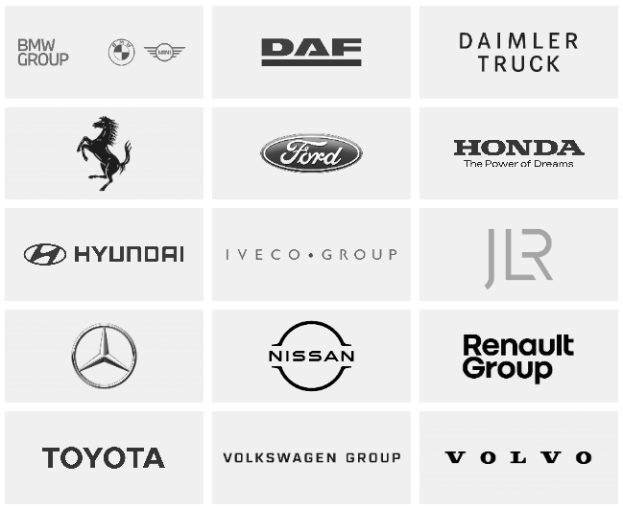
About ACEA
ACEA (European Automobile
  Manufacturers Association) represents the interests of
  major European car, truck
  and bus manufacturers.
Sets performance
specifications for engine lubricants through its
European Oil Sequences.
ACEA performance specifications increasingly adopted outside Europe.
www.atiel.eu

Slide 8
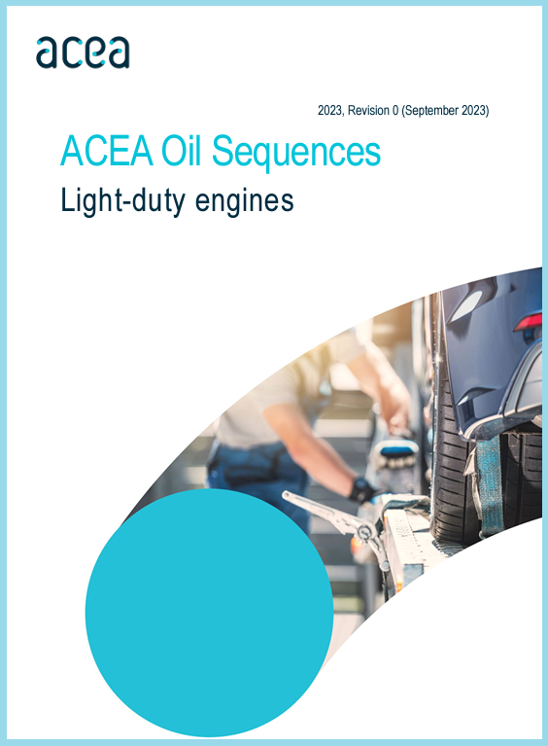
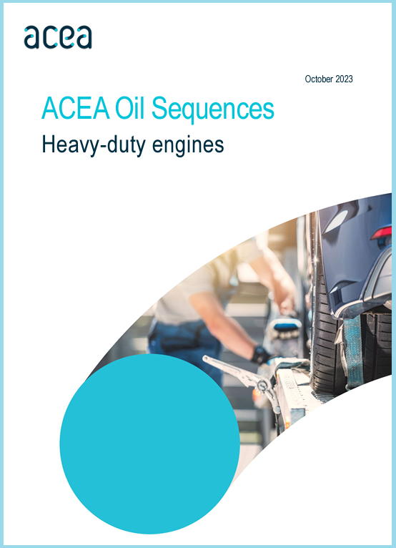
ACEA Oil Sequences
  ACEA European Oil Sequences cover light-duty passenger cars & heavy-duty trucks.
  The ACEA Oil Sequences are updated regularly to address:
    Changes in European legislation
    Changes in engine technology
    Changes in fuel composition
  The current issues of the Oil Sequences are ACEA 2022 for Heavy–duty engines and ACEA 2023 for Light-duty engines.
www.atiel.eu

Slide 9
Validity of ACEA Oil Sequences ?
Light-duty
Sequence issue | First allowable use | Mandatory for new formulation claims | Oils with this claim may be marketed until
2004 | 1st Nov 2004 | 1st Nov 2005 | 31st Dec 2009
2007 | 1st Feb 2007 | 1st Feb 2008 | 23rd Dec 2010
2008 | 22nd Dec 2008 | 22nd Dec 2009 | 22nd Dec 2012
2010 | 22nd Dec 2010 | 22nd Dec 2011 | 22nd Dec 2014
2012 | 14th Dec 2012 | 14th Dec 2013 | 1st Dec 2018
2016 | 1st Dec 2016 | 1st Dec 2017 | 1st May 2023
2021 | 1st May 2021 | 1st May 2022 | 1st August 2025
2023 | 12th Sep 2023 | 12th Sep 2024
www.atiel.eu

Slide 10
Validity of ACEA Oil Sequences ?
Heavy-duty
Sequence issue | First allowable use | Mandatory for new formulation claims | Oils with this claim may be marketed until
2004 | 1st Nov 2004 | 1st Nov 2005 | 31st Dec 2009
2007 | 1st Feb 2007 | 1st Feb 2008 | 23rd Dec 2010
2008 | 22nd Dec 2008 | 22nd Dec 2009 | 22nd Dec 2012
2010 | 22nd Dec 2010 | 22nd Dec 2011 | 22nd Dec 2014
2012 | 14th Dec 2012 | 14th Dec 2013 | 1st Dec 2018
2016 | 1st Dec 2016 | 1st Dec 2017 | 1st May 2024
2022 | 1st May 2022 | 1st May 2023
www.atiel.eu

Slide 11
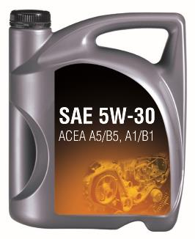
ACEA performance claims
  Lubricant marketers are responsible
  for all aspects of product liability!
  Lubricant marketers claiming ACEA performance can include claims for specific engine categories
  on their product labelling.
  For these claims to be valid ACEA requires these engine lubricants to be developed in accordance with the European Engine Lubricant Quality Management System (EELQMS).
www.atiel.eu

Slide 12
The European Engine Lubricants Quality Management System (EELQMS)
www.atiel.eu

Slide 13

About the EELQMS
Quality management system for automotive engine lubricants.
Voluntary to participate – only for claims made against the ACEA engine oil sequences. Some OEM approvals may also require participation.
If you choose to participate then the system rules are mandatory, for example the Codes of Practice. You can’t pick and choose.
Developed by industry stakeholders to promote development of improved, fit-for-purpose engine lubricants that meet increasing technical requirements.
Designed to assist lubricant marketers in assuring the quality of their lubricants and the performance claims being made for them in the marketplace for the benefit of end users.
www.atiel.eu

Slide 14
EELQMS stakeholders and inputs
www.atiel.eu

Slide 15
EELQMS contribution to quality
Detailed process and structure for lubricant development, production and performance validation.
Provides assurance of the quality of engine lubricants on the market that claim to meet the performance requirements of ACEA.
A quality management voluntary system but the ONLY system that can be used to qualify engine lubricants against ACEA Oil Sequences.
Administered by ATIEL on behalf of the other key stakeholders.
www.atiel.eu

Slide 16

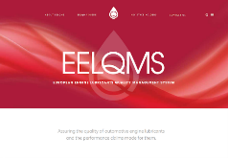
Promoting EELQMS
New identity with logo and branding.
New separate document clearly setting out the guidelines for compliance with EELQMS.
New dedicated website: www.eelqms.eu
Logo can be used in marketing material under license, but only
by signatories of EELQMS.
www.atiel.eu

Slide 17
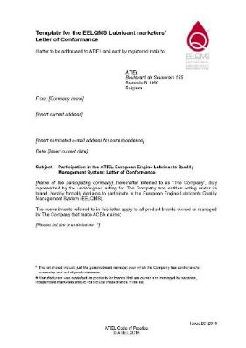
Summary of EELQMS guidelines
Lubricant marketers developing engine lubricants in compliance with ACEA Oil Sequences shall carry out formulation development, blending and marketing in accordance with the guidelines in the ATIEL Code of Practice and ATC Code of Practice:
  incorporating EELQMS guidelines in a quality management system (e.g. ISO 9001)
  ensuring an independent audit of the lubricant development process.
  having Code of Practice checklists signed off by an authorised company representative.
  blending products according to requirements of ATIEL Code of Practice, including accreditation to an auditable QMS.
  signing a Marketers’ Letter of Conformance and registering it with ATIEL.
www.atiel.eu

Slide 18

Marketer’s Letter of Conformance
Compliance with the EELQMS includes signing a Lubricant Marketers’ Letter of Conformance:
  Required for ACEA performance claims
  Declaration of compliance with EELQMS by the lubricant marketer
  Signed Letters held by SAIL of behalf of ATIEL (EELQMS administrator)
  List of signatories on SAIL website
  Renewed annually
  Membership of ATIEL not required to be a signatory
  Letter of Conformance template available
  from SAIL website: www.sail-europe.eu
www.atiel.eu

Slide 19
Role of SAIL –
Monitoring quality in the market
www.atiel.eu

Slide 20
SAIL’s Role in EELQMS
SAIL operates the registration system of the signatories of the Letter of Conformance, and on behalf of ATIEL, in association with ATC and ACEA, licences the use of the EELQMS quality trademark.
SAIL has been contracted by ATIEL to provide administrative, financial and management services in support of ATIEL's product compliance and Letter of Conformance activities on a non-profit making basis.
SAIL is responsible for ATIEL's product compliance monitoring programme.
SAIL ensure all survey reports and summaries are anonymised to avoid potential conflicts of interests between members and participants
www.atiel.eu

Slide 21
Did you know …?
… in 2023, ATIEL/SAIL sponsored over 4000 individual tests as part of the Lubricant Marketers’ Letter of Conformance compliance program
… ACEA lubricants have a truly global reach with over four hundred participants in sixty-three countries across six continents
… ACEA is a full and active participant in the process, having co-signed over 50 letters sent to lubricant marketers in 2022/23
… Letter of Conformance scheme participants are licensed to use the EELQMS logo on their packaging demonstrating that their lubricant meets the minimum standards of leading European vehicle manufacturers
www.atiel.eu

Slide 22
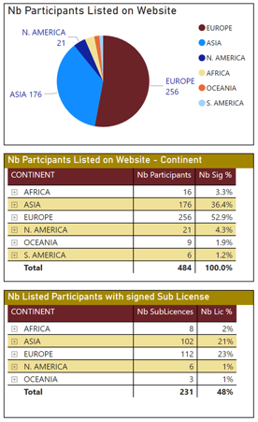
Number of registrants 09/09/2024
Listed on website = 484
All listed participants signed LoC
Number of signed sub-license agreements
231 signed sub-license agreements from participants listed on the website

Slide 23
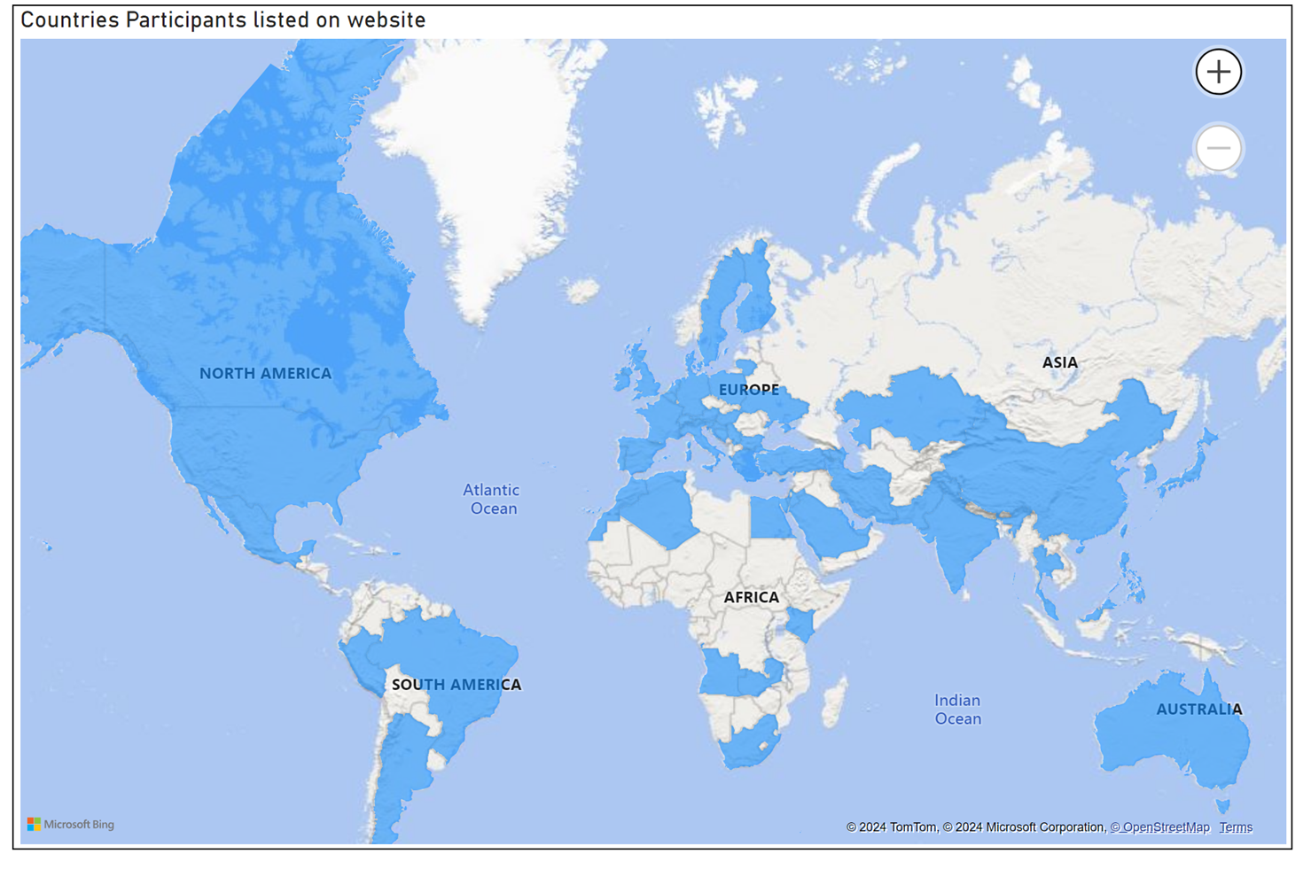
Global Reach
www.atiel.eu

Slide 24
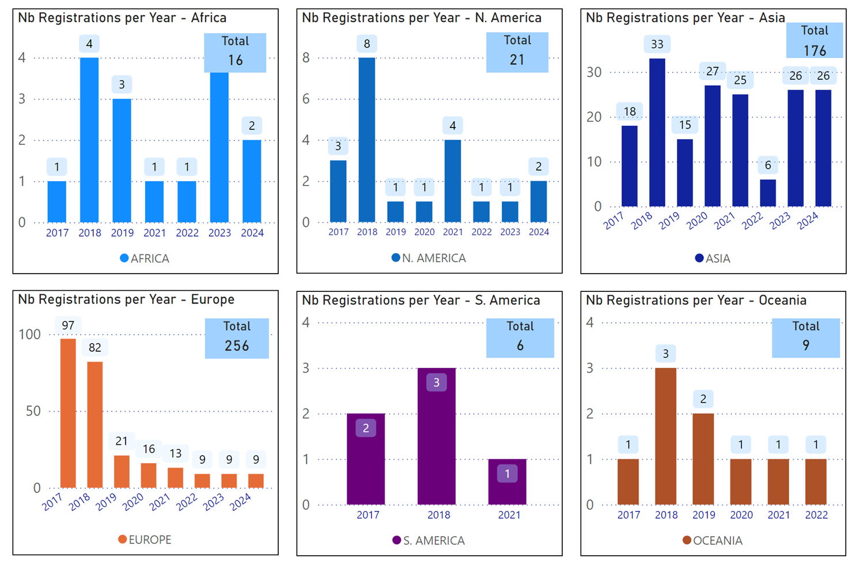
New Registrations
by Region
www.atiel.eu

Slide 25
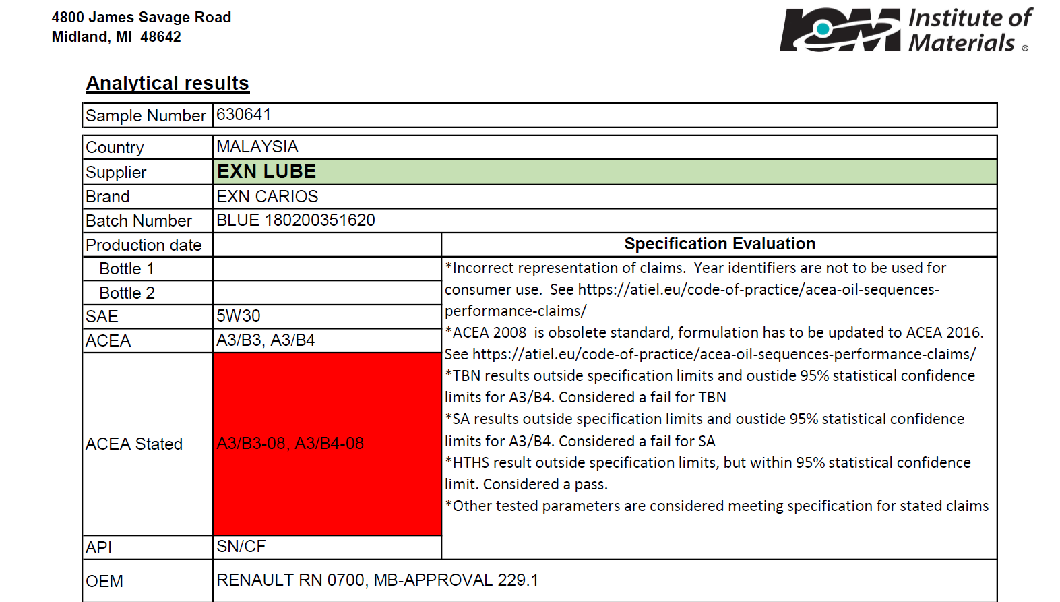
Example Report
www.atiel.eu

Slide 26
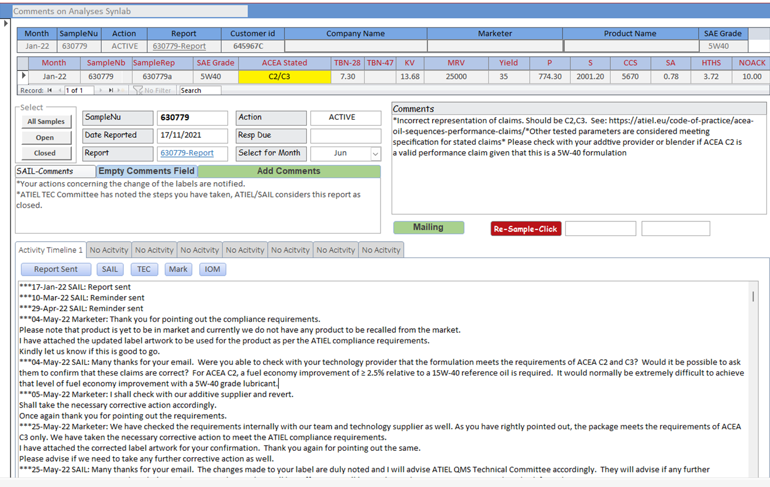
Example Report Tracking
www.atiel.eu

Slide 27
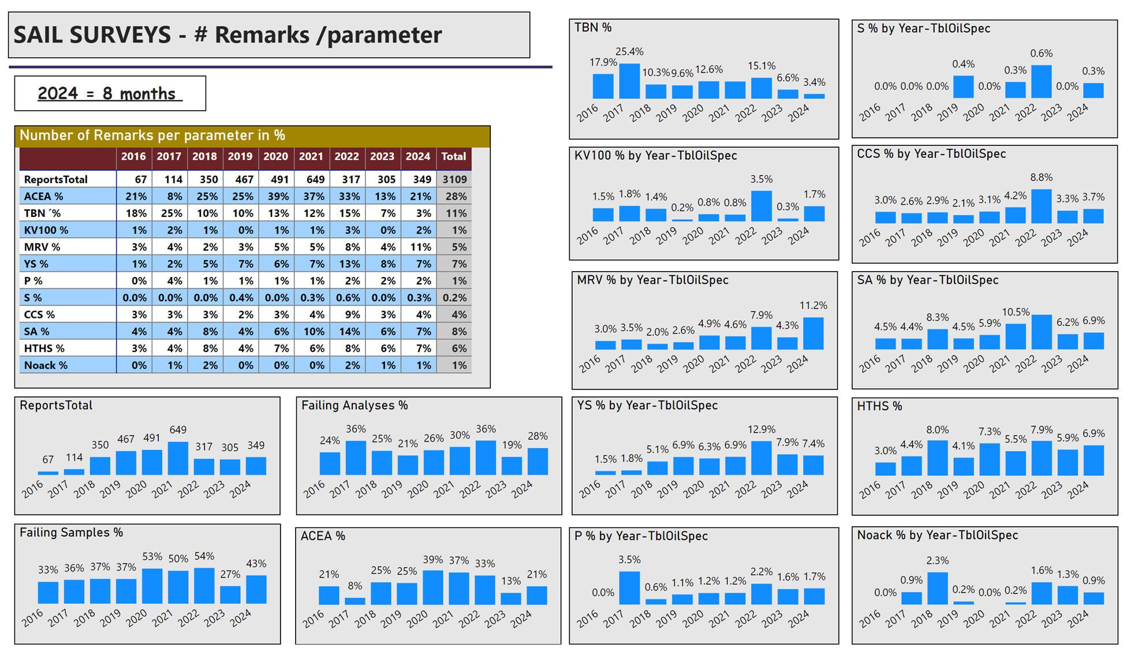

Slide 28
A Very Bad Example
www.atiel.eu

Slide 29

Thank you!
Any questions?
For more information visit:
www.atiel.eu
www.sail-europe.eu
www.eelqms.eu
www.acea.be

